Slide 1
Design Project
Pillar 2
Dhaval Bhailalbhai Patel
Nidhi Saseendran

Slide 2
PROBLEM DEFINITION
The principal problem with the current RCE is that the content of the website is not organized properly and there is no data flow on the website. The sections of the website are not properly grouped and there is no symmetry on the website

Slide 3
NORTH STAR CUSTOMER
Our North Star customer is the general public and politicians because we believe that we need to project RCE Saskatchewan and it’s work to the common public so as to demonstrate its contribution towards UN goals and what it is doing for the local and global communities. In this way, we can also involve people in the RCE Saskatchewan working and they can also contribute to the community and development of RCE as well.

Slide 4
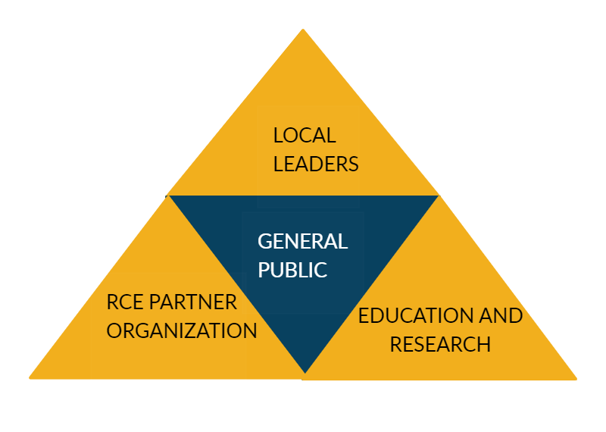
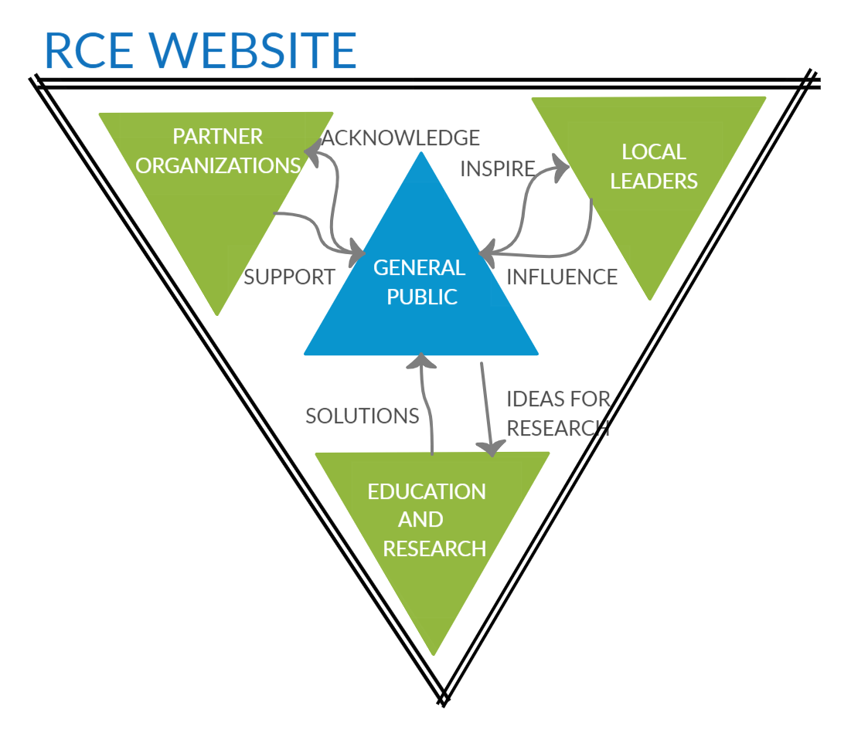
ECO SYSTEM
We would like to take an incremental approach for development of the website our main focus is to connect general public which is our north star customer with the RCE SK this will intern attract other carry over customers like local leaders, local partner organizations and Education and research community

Slide 5
PROBLEMS
How we can organize our website?
What additional features can we add to our website?
How we can display our events and news?
How we can reach out to people?
What customer base should we focus on most?
How can we display our events ?
How can we rise funding through our website?
How can we resolve security problems?

Slide 6
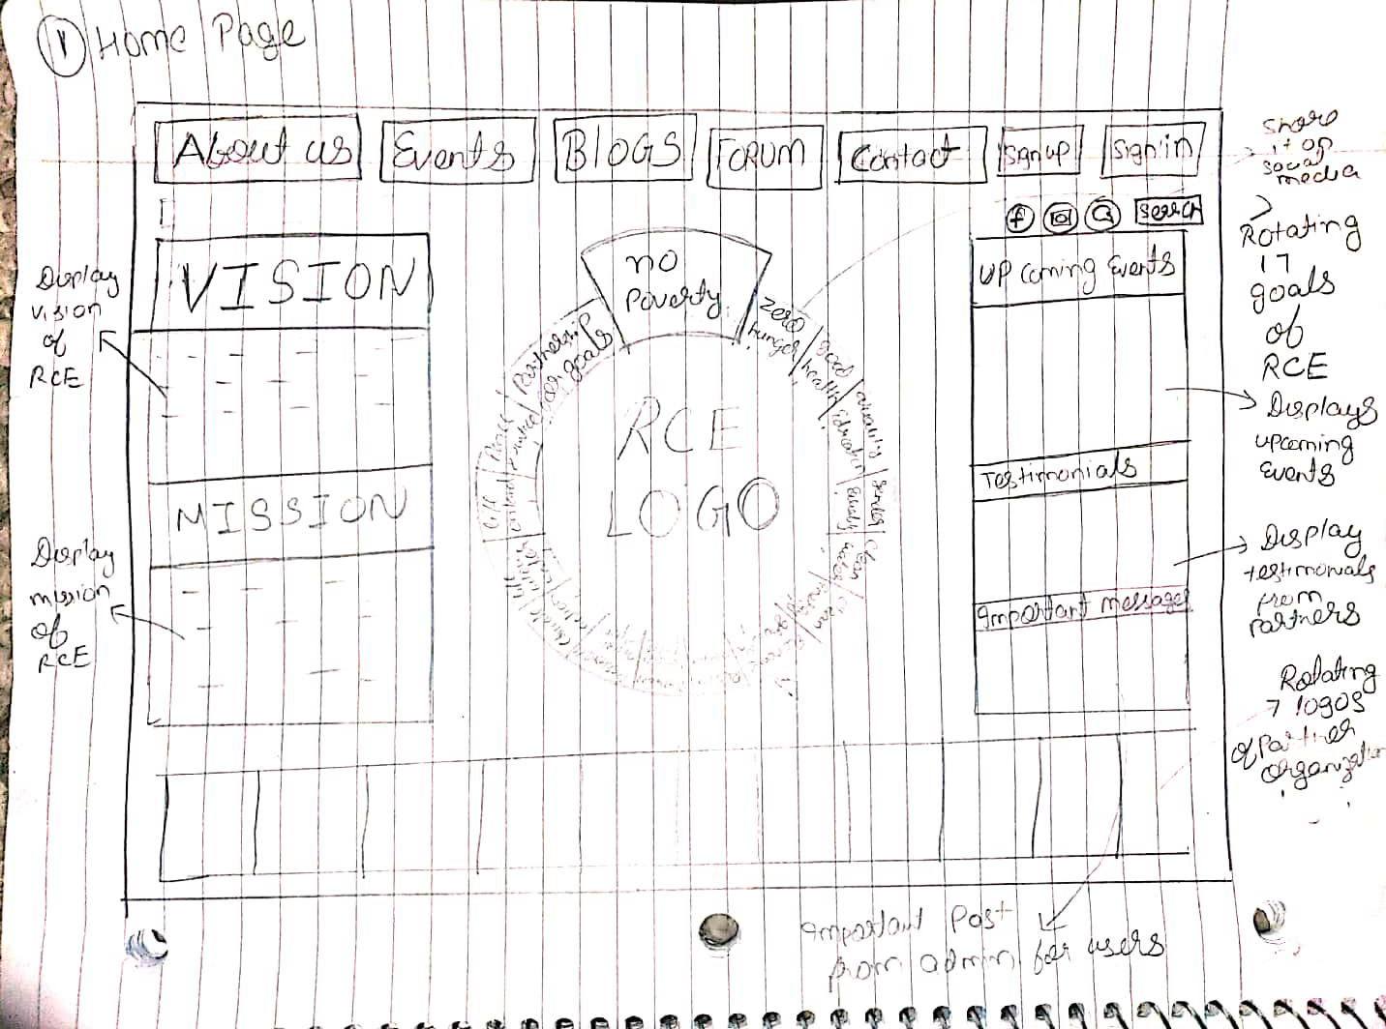
SOLUTIONS
We tried to design our website in a way that it matches Saskatchewan flag and color schemes are matched as well.
We tried to solve the major concerns by our stake holders
The design of the page is made keeping 17 goals in mind.
There are various features like denotations, testimonial and events organizations.

Slide 7
DEMO

Slide 8
THANK YOU
QUESTIONS ?

